Slide 1
Session 3:
System Analysis & Design
From Requirements to Technical Blueprints
Introduction to Software Engineering | HUFLIT University
Introduction to Software Engineering

Slide 2



Learning Outcomes
Mapping Knowledge
Unified Workflow
Model Engineering
Learn to translate functional and non-functional requirements into standardized UML models.
Master the flow from Use Cases through Activity and Sequence diagrams to Class structures.
Understand how to ensure cross-diagram consistency and generate code from visual designs.
Slide 2

Slide 3

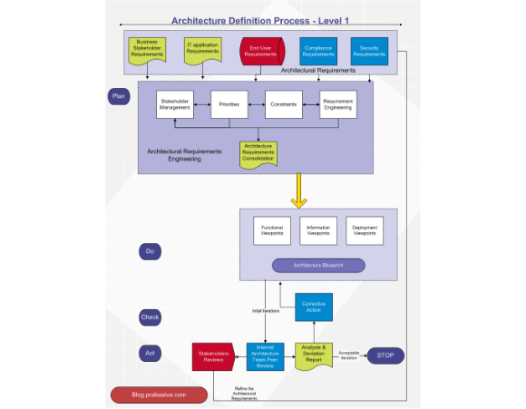
Analysis vs. Design
Analysis: Focuses on "What" the system should do (Requirement understanding).
Design: Focuses on "How" the system will fulfill those needs (Logical structure).
The transition requires abstracting real-world entities into software constructs.
Industrial Case: In bank ATM development, analysis defines "Withdraw Cash", design defines the "CashDispenser" class interaction.
Slide 3

Slide 4
UML: Why We Model?
Visual modeling allows us to manage complexity. Standardized notation (UML) ensures all stakeholders—from architects to coders—speak the same technical language.
•
Visualization: Sees the big picture of a large codebase.
•
Communication: Discusses logic without looking at 10,000 lines of code.
•
Precision: Defines interfaces and behaviors unambiguously.
Slide 4
Slide 4

Slide 5

The Unified UML Workflow
Connecting Requirements to Use Cases, Activity, Sequence, and Class Models
Slide 5

Slide 6
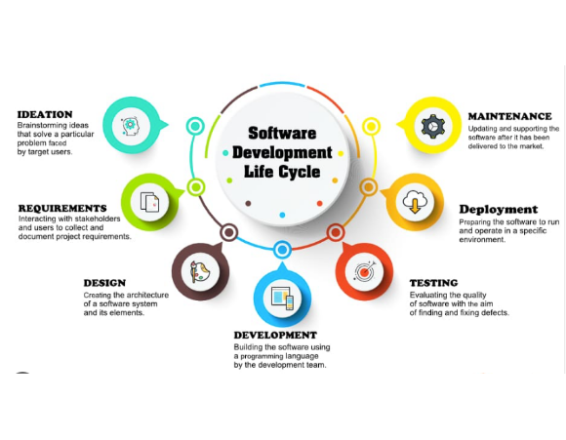
The Unified Flow
Effective modeling follows a logical Pedagogical Flow:
Use Case: Why are we building this?
Activity: What are the steps?
Sequence: Who talks to whom?
Class: How is the data structured?
This session follows this path to build a consistent system view.
Slide 6

Slide 7
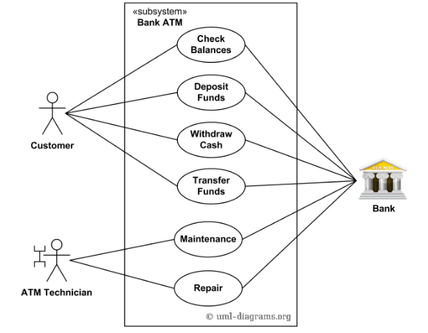
Step 1: Use Case Diagram
Defining Boundaries
The System Boundary box separates what is inside from what is outside.
Focuses on the high-level services provided to actors.
Ignores implementation details (classes/databases).
Industrial Case: Banking systems distinguish between a 'Customer' actor and a 'Bank Administrator' actor.
Slide 7

Slide 8
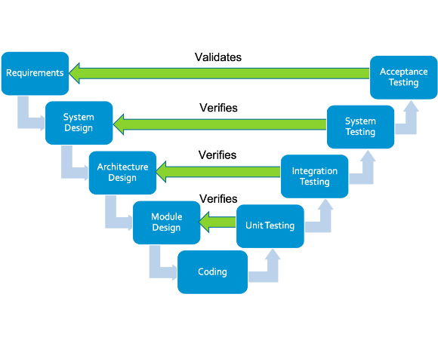
Functional Mapping
FR → Use Case Diagram
Every User Goal becomes a Use Case.
Actors represent roles (Human or System) interacting with the boundary.
Identifies External Traceability back to the User Requirement document.
Real-world Example: "The system must allow a user to transfer funds" maps to a "Transfer Funds" Use Case.
Slide 8

Slide 9

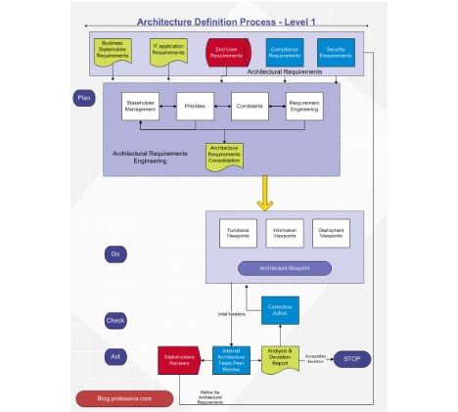
Identifying Use Cases: The Verb-Noun Rule
To identify Use Cases from a requirements document, look for Action-oriented Statements:
Find the Verbs: Identify the primary action (e.g., Generate, Register, Update).
Find the Nouns: Identify the object being acted upon (e.g., Report, Patient, Profile).
Formula: Use Case Name = [Verb] + [Noun Phrase].
Rule of Thumb: A Use Case should yield a Result of Value to the actor.
Slide 9

Slide 10
Step-by-Step Mapping: Practical Example
Functional Requirement (FR) Text | Keywords (Verb/Noun) | Candidate Use Case
"The system shall allow the clerk to register a new patient." | Register / Patient | Register Patient
"A doctor must be able to view the medical history." | View / History | View Patient Record
"The system shall generate a weekly revenue report." | Generate / Report | Generate Revenue Report
Slide 10

Slide 11
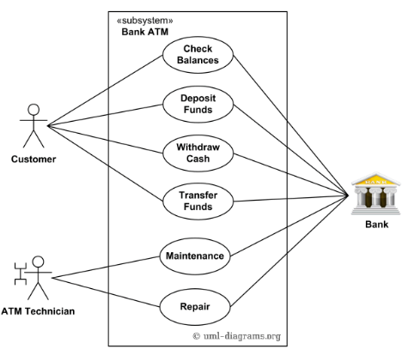
Identifying Actors: Who initiates the Goal?
Questions to ask the FR:
Who provides the input for this requirement? (Primary Actor).
Who receives the output or value?
Does this requirement interact with an External System? (e.g., Credit Card Gateway).
Does it happen automatically on a Timer? (Time as an Actor).
Industrial Case: In a Retail System, the "Inventory Manager" is an actor for "Update Stock", while "Payment Gateway" is a supporting system actor.
Slide 11

Slide 12
Refining Scope: Atomicity of Use Cases
Common Pitfalls to Avoid:
Too Small: "Click Button" is a UI step, not a Use Case.
Too Large: "Manage Hospital" is an entire system, not a Use Case.
Consistency Check: A single Use Case usually covers several related FRs (e.g., "Create", "Edit", and "Delete" can often be grouped into "Manage User Profile").
Goal: Ensure each Use Case represents a complete task from start to finish.
Slide 12

Slide 13
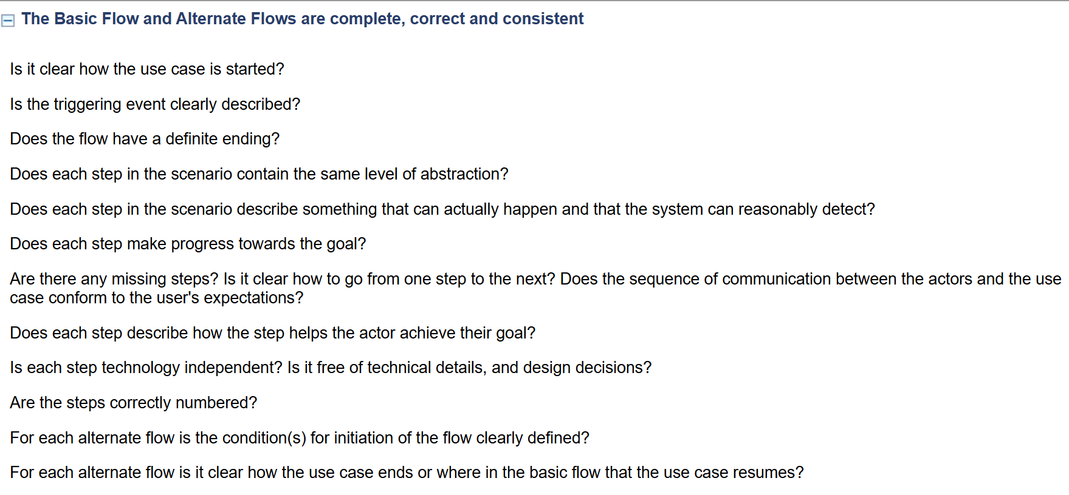
Use Case Scenarios
A diagram is just a table of contents; the Scenario is the story.
Main Success Scenario: The "Happy Path" where everything works.
Extensions/Alternative Scenarios: Dealing with errors or conditional branches.
Textual descriptions bridge the gap between human language and process logic
Core Message: Don't just draw; document the behavior!
Checklist for Use case specification
Slide 13

Slide 14
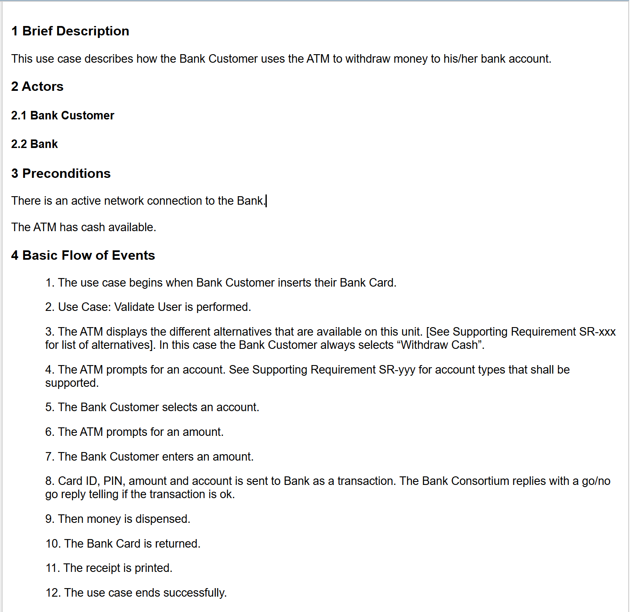
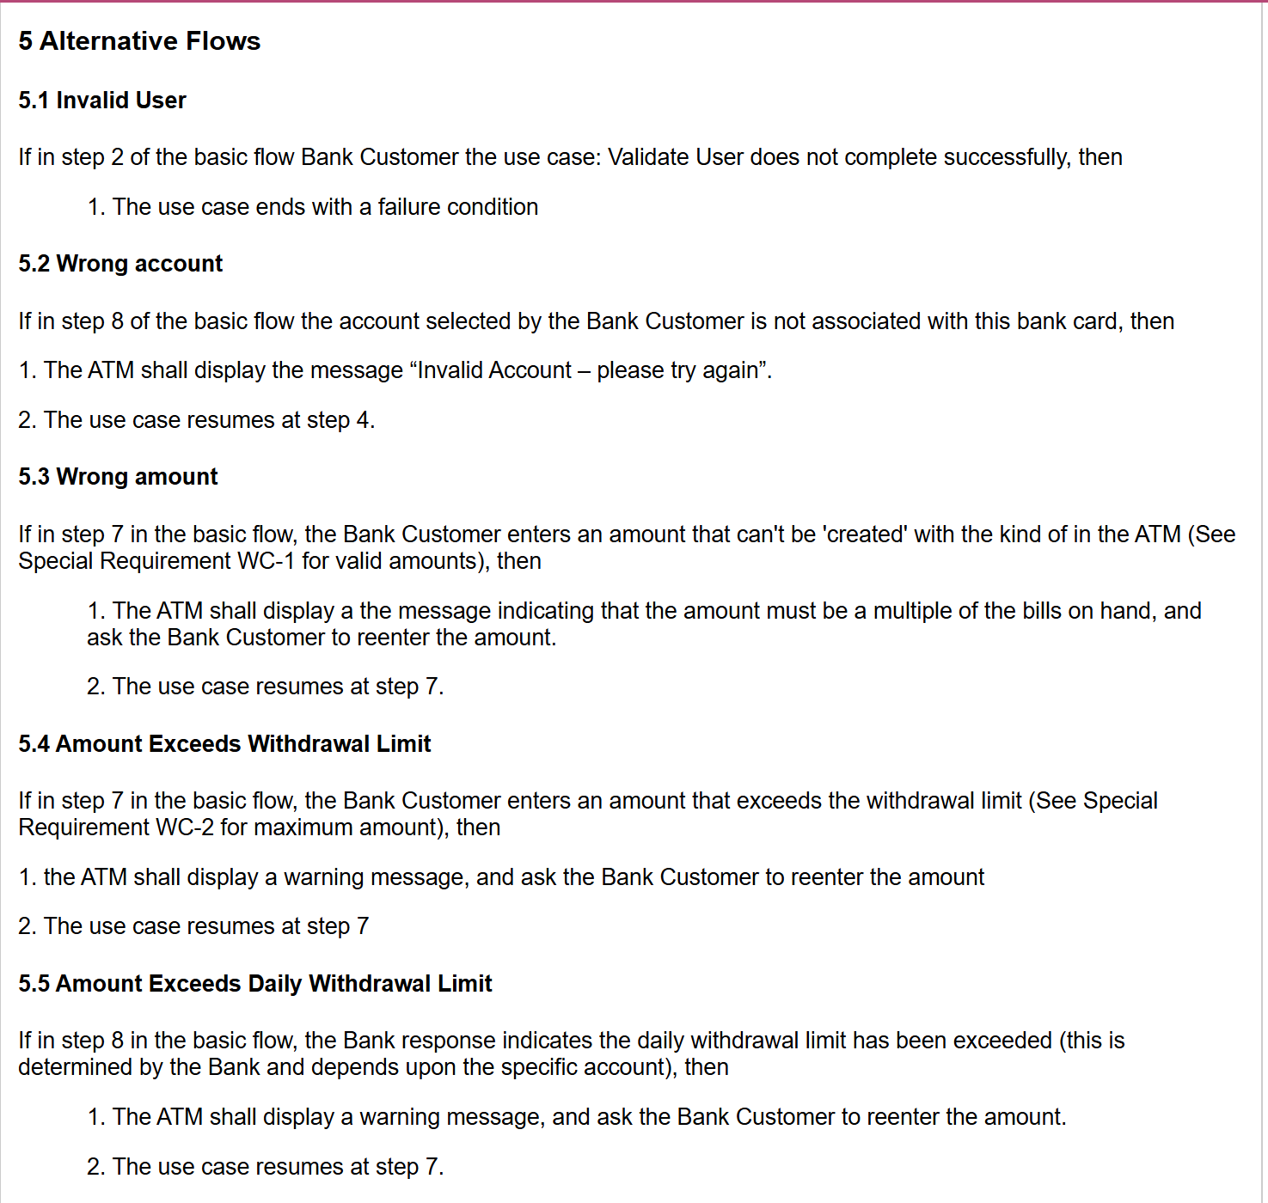
Use Case Scenarios: Example
Slide 14

Slide 15
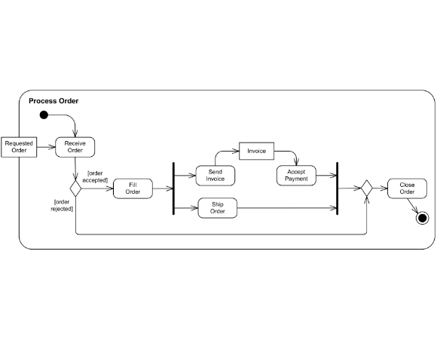
Step 2: Activity Diagram
Mapping Business Logic
Used to model the workflow within a Use Case.
Shows decisions (diamonds), concurrency (bars), and synchronization.
Essential for identifying complex business rules.
Industrial Case: Modeling the 'Check Credit' and 'Process Payment' steps in an online checkout.
Slide 15

Slide 16
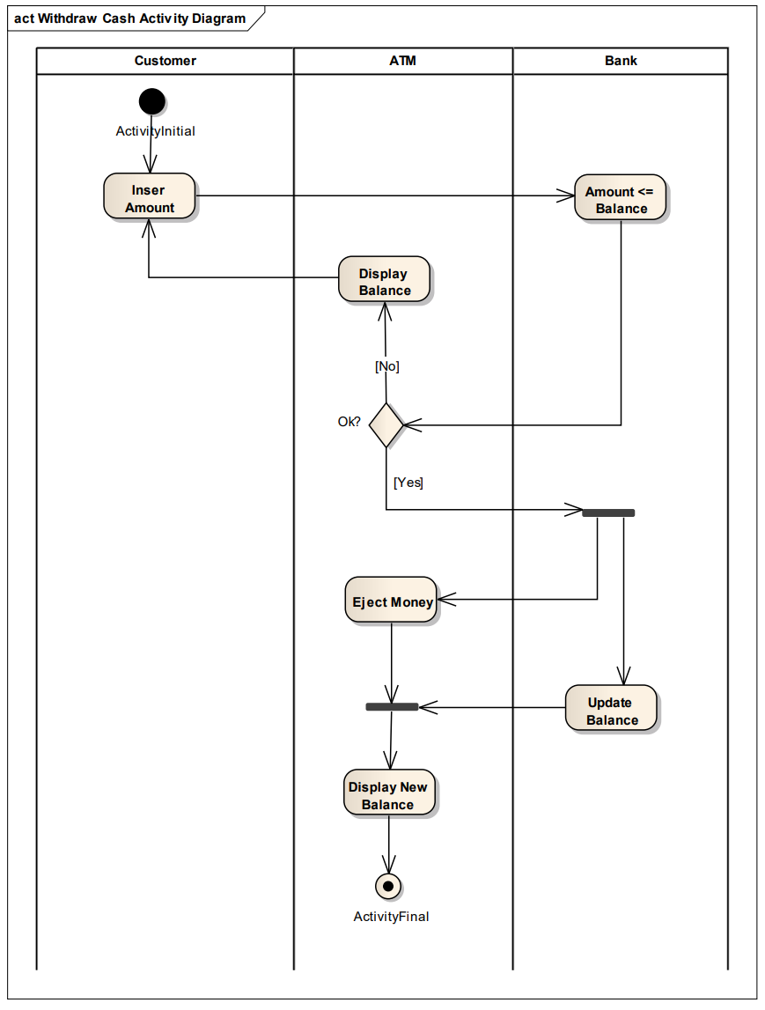
Visualizing Flow Control
Fork & Join: Visualizing parallel operations (e.g., sending e-mail and logging simultaneously).
Swimlanes: Identifying which department/object is responsible for which activity.
Helps discover hidden requirements in complex branching logic.
Example: A logistics system where 'Warehouse' and 'Shipping' have parallel workflows.
Slide 16

Slide 17
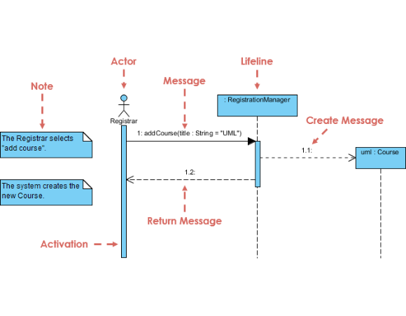
Step 3: Sequence Diagram
Interaction Modeling
Shows how objects interact via messages over time.
Maps the Scenario to actual logical instances.
Lifelines: represent object lifetimes; arrows show method calls. Boundary, Controller, Entity
Temporal Order: Vital for real-time systems
Activation: Bars indicating when an object is performing a task.
Return Values: Dashed arrows providing data back to the original caller.
Industrial Case: Verifying the "Log-in" handshake between UI, Controller, and DB.
Slide 17

Slide 18
Discovering Objects
Sequence diagrams help us find necessary classes.
If a message is sent to "AccountManager", we must have an "AccountManager" class.
Synchronous calls (filled arrow) vs Asynchronous messages (stick arrow).
Identifying Dynamic Responsibility: Which object holds the control logic?
Core Message: Interaction reveals structure.
Slide 18

Slide 19
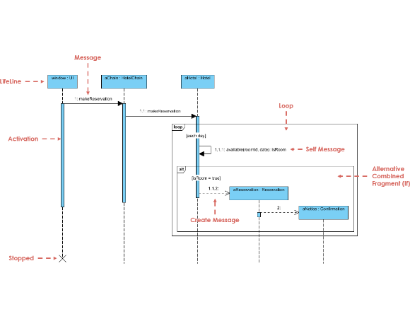
Messages → Methods
A message in a sequence diagram must correspond to an operation in a class.
This ensures traceability from behavioral modeling to structural modeling.
Parameters in the message become arguments in the method signature.
Real-world Check: If you can't find a receiving method, your class design is incomplete!
Slide 19

Slide 20
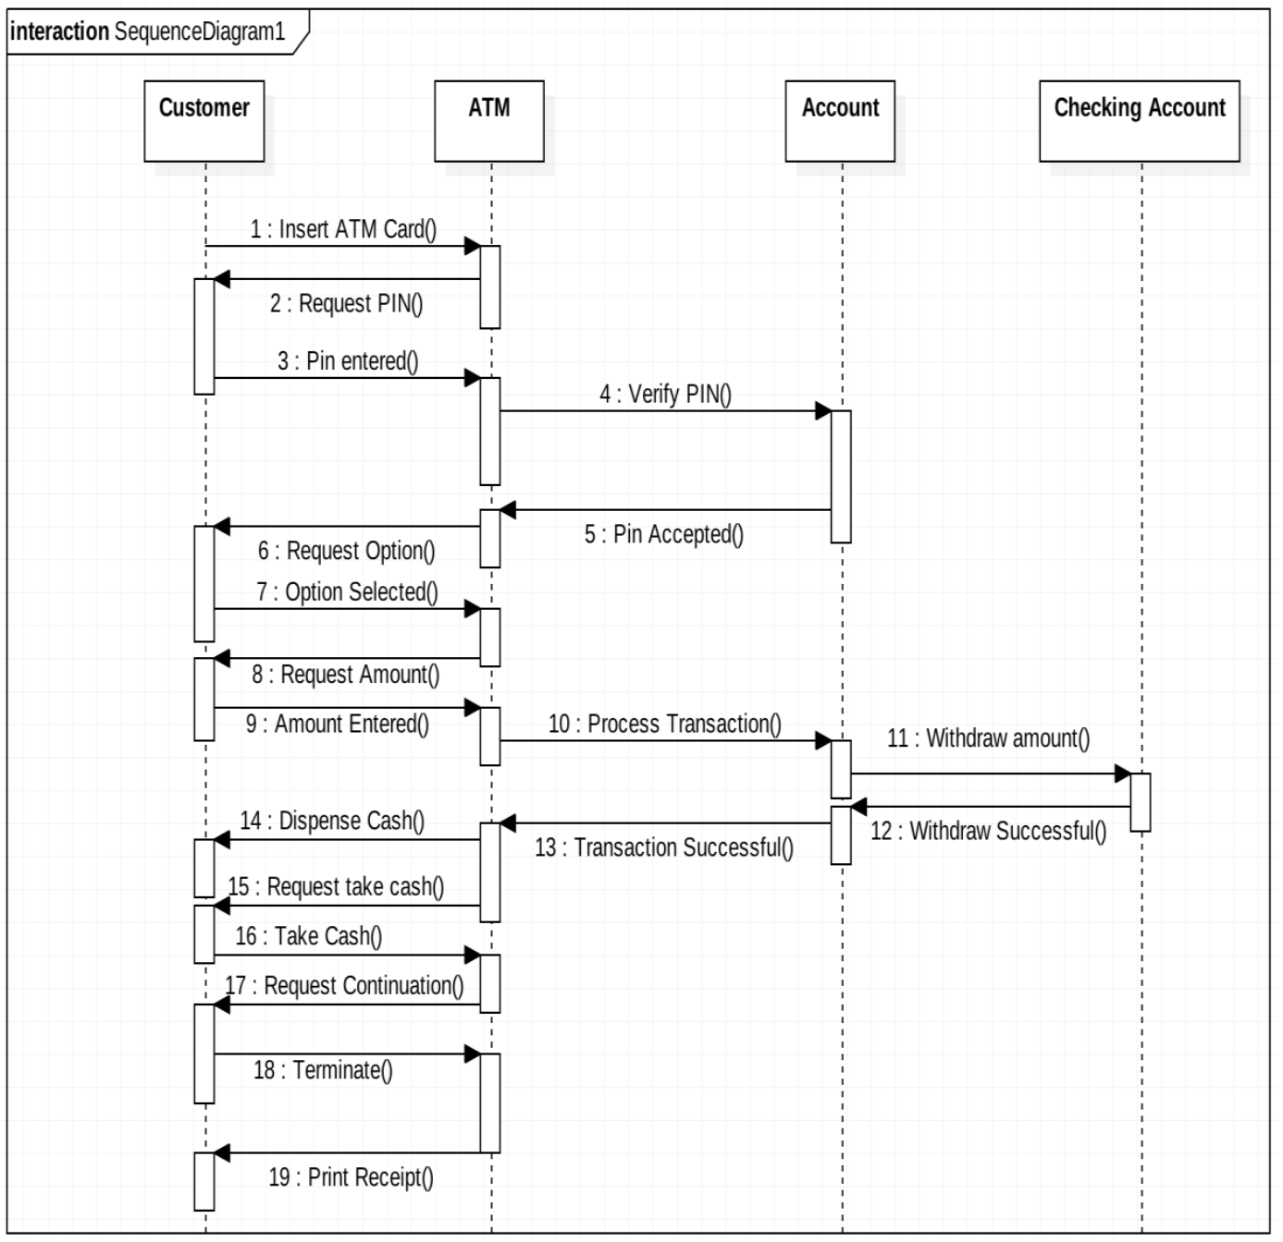
Example: ATM Withdrawal Cash
Slide 19

Slide 21
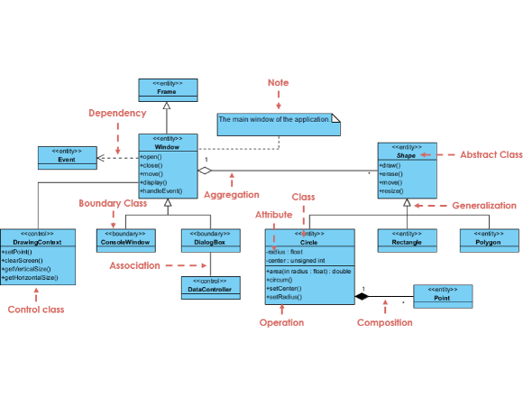
Step 4: Class Diagram
The Technical Blueprint
Defines the static structure of the system.
Includes Class Name, Attributes, and Operations.
Relationships: Association, Aggregation, Composition, Inheritance.
Industrial Case: Defining the 'Person' → 'Employee' → 'Manager' hierarchy in HR software.
Slide 20

Slide 22
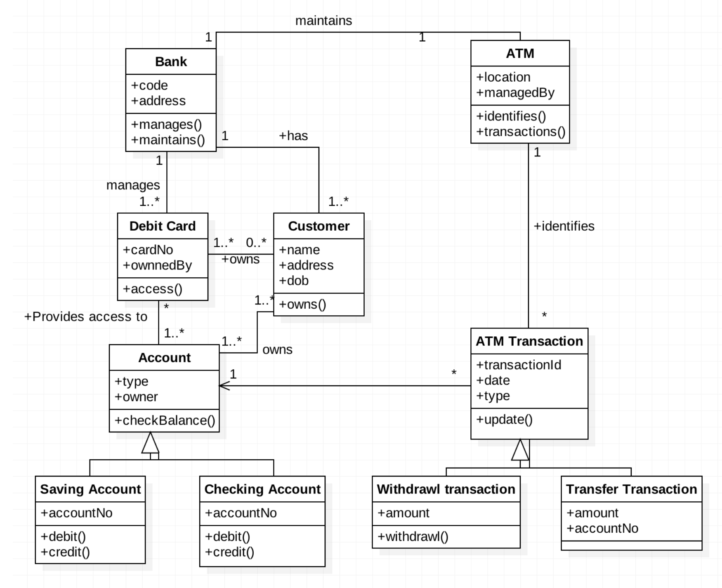
Data to Attributes
Consolidating all nouns and relationships into a data model.
Attributes: Data types for storage
Methods: Derived directly from Sequence messages.
Modifiers: Encapsulation private (-), public (+), protected (#).
Multiplicity: Foundation for Database schema. Mapping relations (1..*, 0..1).
Slide 21

Slide 23
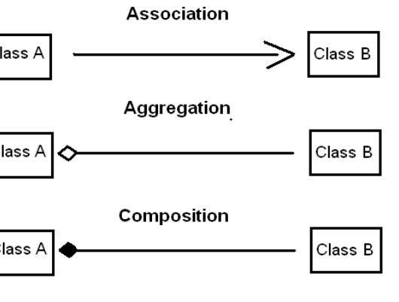
Aggregation & Composition
Modeling "Whole-Part" relationships in software systems.
Aggregation: Shared part (Diamond symbol). Example: A University contains many Departments.
Composition: Strong ownership; if the whole is destroyed, parts are too. Example: A Folder contains Files.
Slide 22

Slide 24


Generalization (Inheritance)
A mechanism to manage complexity by grouping common features in a Super-class.
Sub-classes Inherit attributes/methods.
Reflects "is-a" relationship (e.g., GP is-a Doctor).
Super-class: Doctor
Reduces code duplication and enforces logic standards.
Sub-classes: Surgeon, GP, Specialist
Slide 23

Slide 25

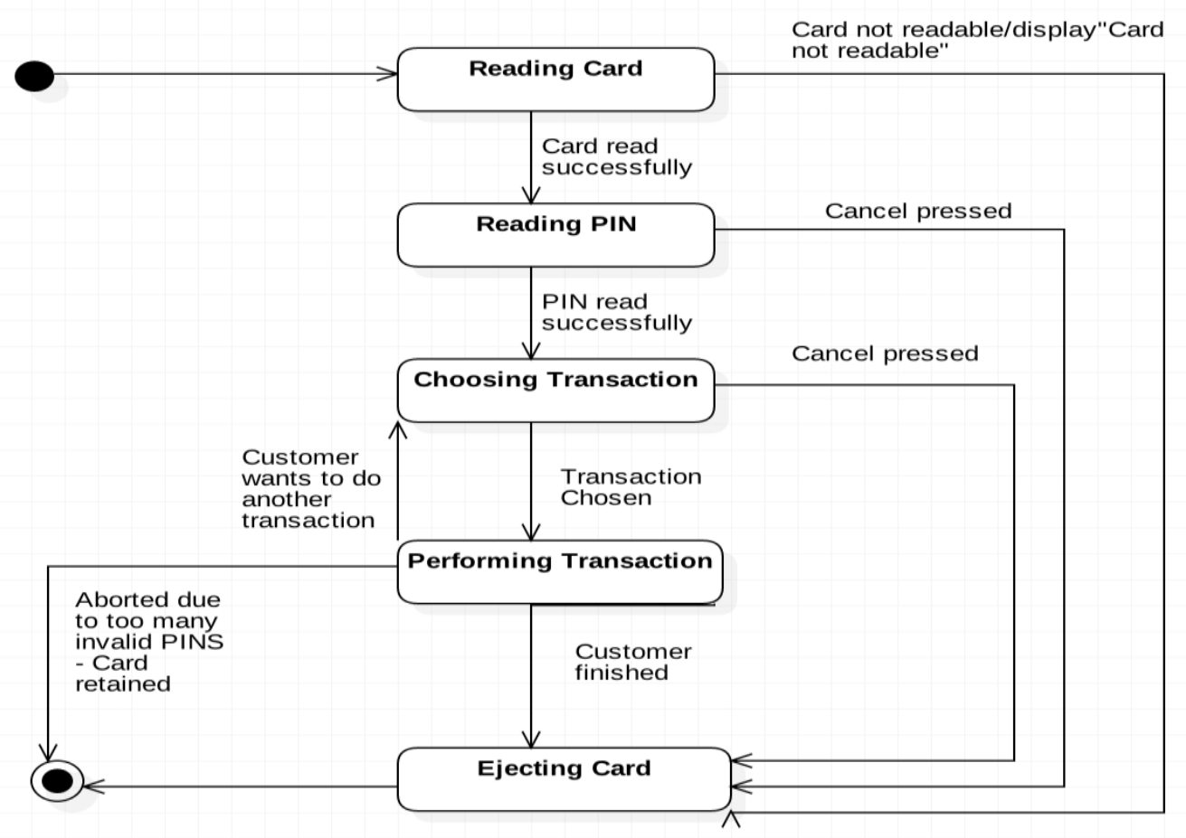
Step 5: State Machine Diagram
Tracking the "status" of complex objects (e.g., Account).
States: Active, Frozen, Closed.
Triggers: Events that change state.
Guards: Constraints (e.g., Balance > 0).
Example: a working session of ATM
Slide 24

Slide 26
Checking Design Consistency
Consistency Rule | Verification Point | Action
Message-Method Match | Sequence -> Class | Every message sent to an object must be a method in its Class.
Data Availability | Activity -> Class | Every data item updated in a flow must have an Attribute in the Class.
Valid Transitions | Sequence -> State | Interactions cannot trigger a state change that is disallowed in the State Diagram.
"Industry Architects spend 30% of their time ensuring this 'Single Source of Truth'."
Slide 25

Slide 27
Mapping NFRs to UML
How Constraints Shape the Technical Architecture

Slide 28



Non-Functional Impact
Security
Performance
Availability
Leads to the creation of Authentication components and Authorization logic in sequence diagrams.
Impacts architectural choices (e.g., Load Balancers) and reduces object message overhead.
Directs the design toward redundant server nodes and fail-safe state transitions.
Slide 27

Slide 29
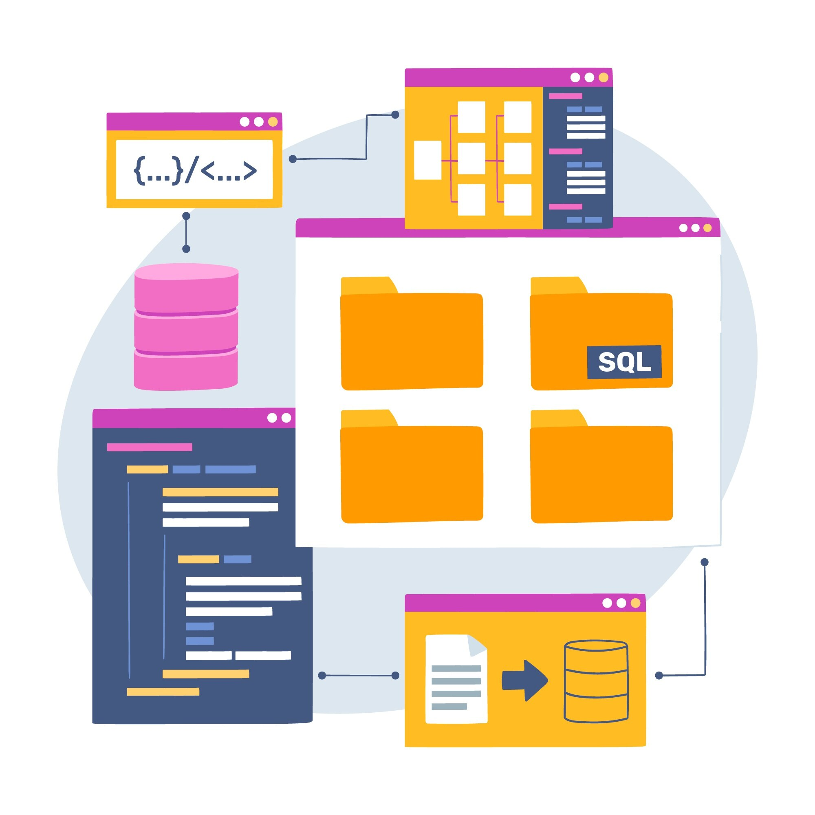
NFRs: The "Architectural Drivers"
Non-Functional Requirements (NFRs) act as constraints that shape the Architectural Structure:
They often don't map to a single "Use Case".
They impact the Global Design (How objects are distributed).
They define the "Quality" of the functional execution
Key Insight: if an NFR is ignored during analysis, the system might work correctly but fail in production (e.g., too slow or insecure).
Slide 28

Slide 30


Mapping Security NFRs
1. Use Case Diagram
2. Sequence Diagram
Use Misuse Cases to model threats. Define "Authenticate" as an «include» relationship for sensitive operations.
Model the Security Handshake. Show messages to an "AuthorizationService" before returning sensitive data.
3. Class Diagram
4. Deployment Diagram
Add specialized classes: Encrypter, AccessController, or AuditLog to handle data integrity.
Model Firewalls and DMZs (Demilitarized Zone). Specify secure protocols (HTTPS/SSL) between nodes.
Slide 29

Slide 31

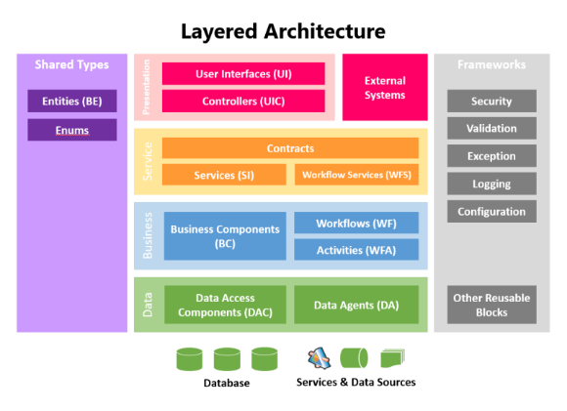
Mapping Performance NFRs
Design for Speed
Activity Diagram: Identify bottleneck activities and model them as Parallel Processes (Fork/Join).
Sequence Diagram: Use Asynchronous Messages to prevent UI blocking. Model Caching patterns.
Deployment Diagram: Identify Load Balancers and specify multi-node server clusters.
Slide 30

Slide 32
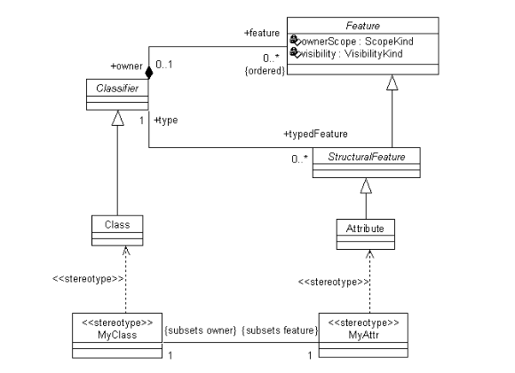
Mapping Availability & Reliability
Design for Resilience
State Diagram: Model Error States and Recovery Transitions (e.g., "Retrying connection").
Sequence Diagram: Include Timeouts and Exception Handling paths between interacting objects.
Deployment Diagram: Specify Redundant Nodes (Active/Passive failover).
Slide 31

Slide 33
NFR Mapping Summary
Non-Functional Requirement | Primary UML Diagram(s) | Key Elements to Model
Security | Use Case, Sequence, Deployment | Includes, Auth Guards, Firewalls
Performance | Sequence, Deployment, Activity | Asynch, Caching, Load Balancers
Reliability | State Machine, Sequence | Error states, Exceptions, Retries
Availability | Deployment | Redundancy, Clusters, Failover
Slide 32

Slide 34
Model Consistency
Ensuring the Integrity of the Design

Slide 35
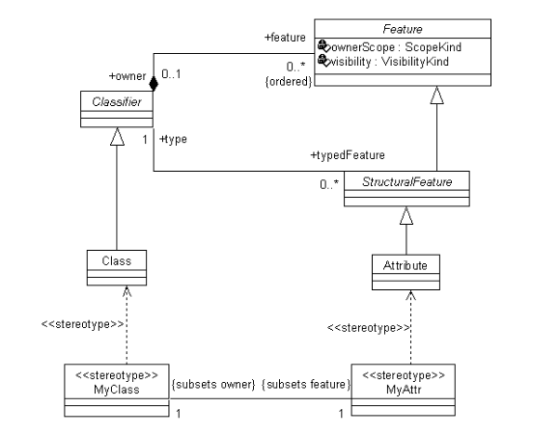
Design Integrity
Syntactic Consistency: Diagrams follow UML grammar (e.g., associations have names).
Semantic Consistency: Behavior aligns with structure (e.g., Sequence calls Class method).
Why check? To prevent implementation errors caused by design gaps.
Industrial Case: NASA uses model integrity checks for mission-critical flight software.
Slide 34

Slide 36
Cross-Diagram Verification
Class vs. Object
Sequence vs. Activity
Attribute Validity
Every object instance in a Sequence diagram must have a corresponding Class in the Class diagram.
The logic flow in Activity diagrams should match the sequence of messages in Interaction models.
Data modified in a Sequence diagram must exist as an attribute in the Class diagram.
Slide 35

Slide 37
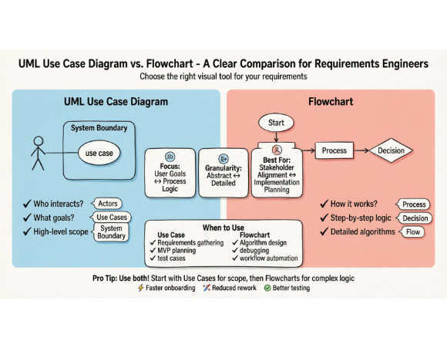
Collaborative Modeling
Models are not just for engineers; they are for Stakeholders.
Use Case diagrams validate system boundaries with clients.
Activity diagrams clarify business rules with domain experts.
Consistency ensures everyone is looking at the Same System.
Slide 36

Slide 38
Vertical Traceability
Tracing a single feature "Check Out":
Requirement: "User must pay for items.“
Use Case: "Checkout."
Activity: "Calculate Total" → "Pay."
Sequence: "Cart" calls "PaymentGateway.process()".
Class: "PaymentGateway" class with "process()" method.
Core Message: Any break in this chain is a design flaw.
Slide 37

Slide 39
Transition to Code
From Models to Executable Reality

Slide 40
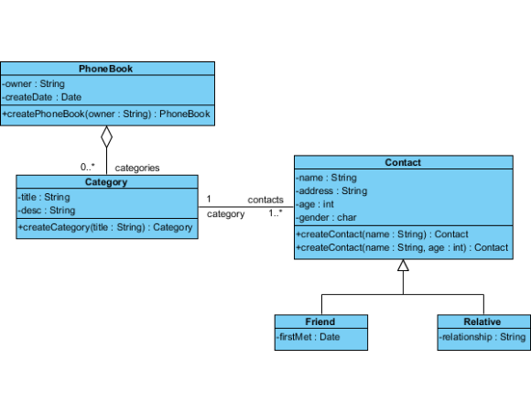
Automated Code Generation
Transforms visual UML models into Skeletal Source Code.
Reduces human transcription errors.
Maintains consistency between design and implementation
Tools like MagicDraw or Rational Software Architect automate this process.
Slide 39

Slide 41
Class to Code Mapping
UML Class → `public class` definition.
Attribute → Private fields with getters/setters.
Operation → Method signatures (declarations).
Associations → Object references or Lists.
Example: `A 1..* B` becomes `private List items` in Class A.
Slide 40

Slide 42
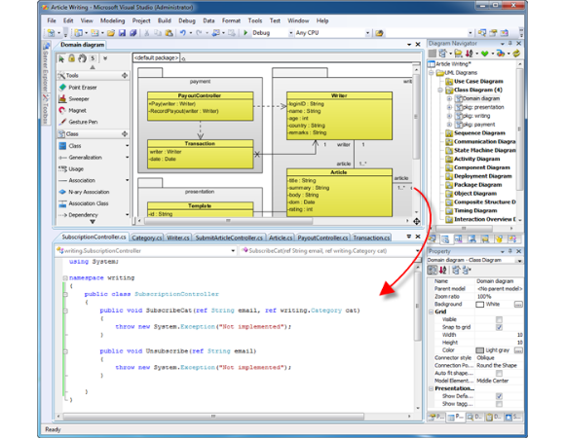
Round-Trip Engineering
The ability to synchronize changes in Code back to Models.
Prevents models from becoming "Shelf-ware" (obsolete documentation).
Essential for maintenance and iterative development.
Industrial Case: Modern IDEs (IntelliJ, Visual Studio) use plugins for real-time model syncing.
Slide 41

Slide 43
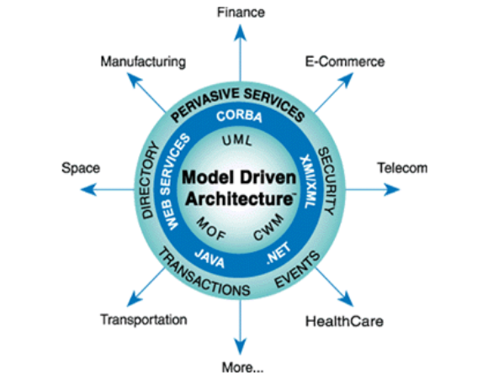
Model-Driven Engineering
Advanced Concept: MDE
Software is treated as a set of Models.
Models are the primary source of truth, not code.
MDA (Model Driven Architecture) separates Platform-Independent from Platform-Specific models.
Allows porting to new languages (e.g., Java → C#) by just changing the generator.
Slide 42

Slide 44
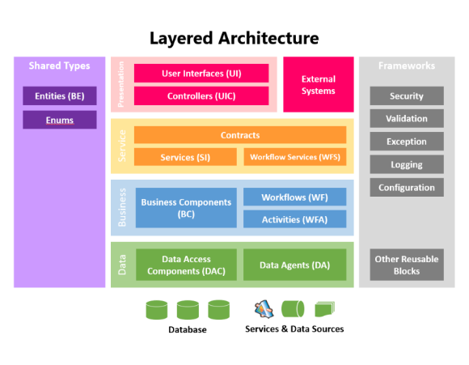
Layered Design Pattern
UML models often follow a Layered Pattern.
Presentation Layer (UI classes).
Application Layer (Service classes).
Data Layer (Repository/DAO classes).
Real-world Case: Large banking apps use layers to isolate sensitive data from UI changes.
Slide 43

Slide 45
Why Automate Generation?
Speed: Generates thousands of boilerplate lines in seconds.
Standardization: Enforces organizational coding standards automatically.
Documentation: Ensures the code structure matches the diagram structure exactly.
Focus: Engineers spend time on Complex Logic, not boring syntax.
Slide 44

Slide 46
Code Gen: The Limits
UML cannot easily represent Algorithmic Complexity (e.g., complex sorting).
Concurrency and state hierarchy can be hard to map 1-to-1 in code.
"Ghost Code": Dead code generated from incomplete models.
Core Message: Code generation is a starting point, not the whole implementation.
Slide 45

Slide 47

Summary & Core Message
Analysis (What) flows into Design (How) via UML.
Consistency across diagrams is the key to software quality.
Models provide the traceability for reliable code generation.
"The model is the Blueprint; The code is the Construction."
Slide 46

Slide 48

Q&A
Thank you for your attention!
huflit.edu.vn / tubtt@huflit.edu.vn
Slide 47

